Slide 1

Team s Stage 4
WaitLess
Team Members:
Edmund
Evan
Karan
Robert
Amman
Teaching Assistant:
Philmo Gu
Notes:
Hello and welcome to the Team S Stage 4 presentation. My names Robert McCurdy and I will be doing our presentation today. Along with myself, my team members include Edmund, Evan, Karan, Amman. Our Teaching Assistant for this class is Philmo Gu.

Slide 2
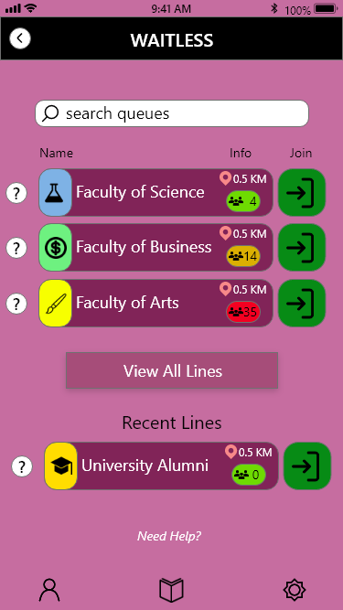
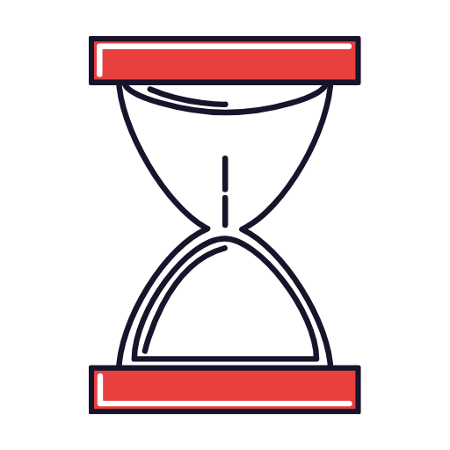
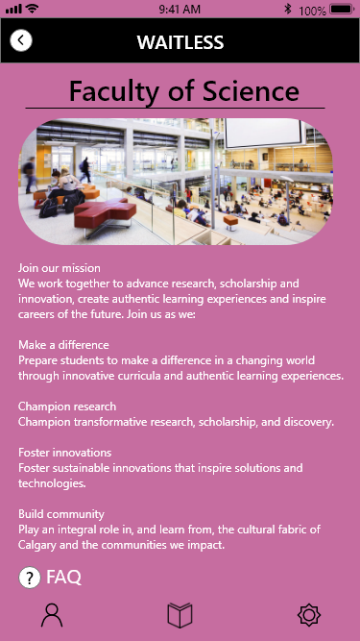
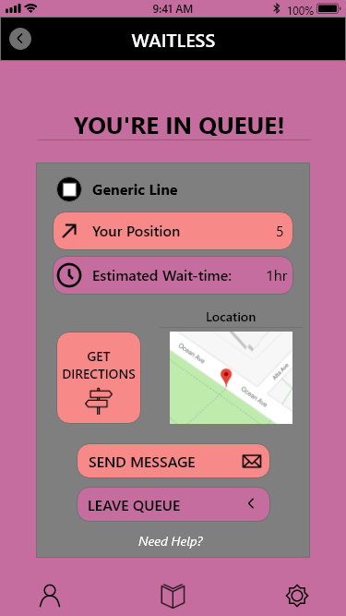
What is waitLESS
Managing and Organizing a Virtual Line
Improve the Virtual Academic Advising Experience for Students
Features to Help and Improve the Process
Take Out the Difficulties and Confusion
Notes:
WaitLess is a mobile app that can manage and organize virtual lines for academic advising. It’s aim is to improve the virtual academic advising experience for students by refining and simplifying a virtual line up system. We went with a mobile application approach as it is the most accessible for students on the go. When they need advising, virtually lining up is as easy as just hitting “Join Line.” While the student waits, they are updated about their placement in line regularly, removing the need for the student to constantly check how long until they are up next. There also includes a chat and FAQ feature that provides the student with quick answers to surface level questions they have. Along with these features, there are many more that we will be covering in our demonstration video. Ultimately, we wanted to take out the difficulties and confusion that new and returning students have with visiting academic advisors, and what better way then with WaitLess.

Slide 3
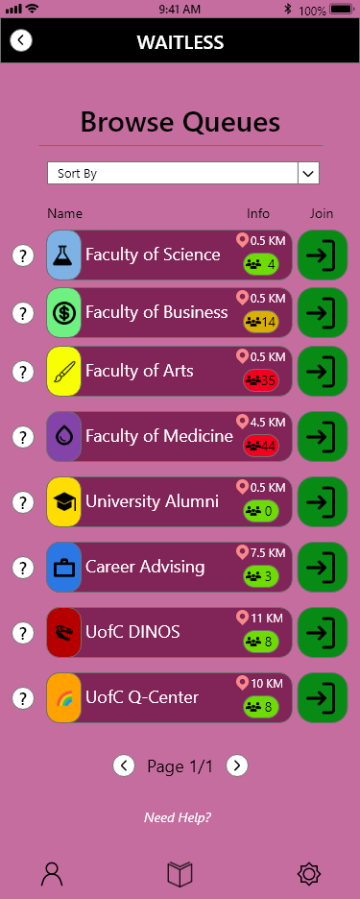
Tasks Prototyped
Search and Browse for Lines/Queues
Notes:
The tasks that we have prototyped in our High Fidelity prototype include firstly searching and browsing for lines. With this, the user is able to either type and search for a specific line they are looking for, or browse for lines that have been sorted into categories. This allows for flexibility for the user, as they have options on how specific or generic they want their searches to be.

Slide 4
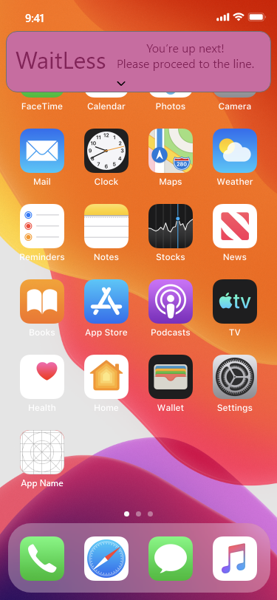
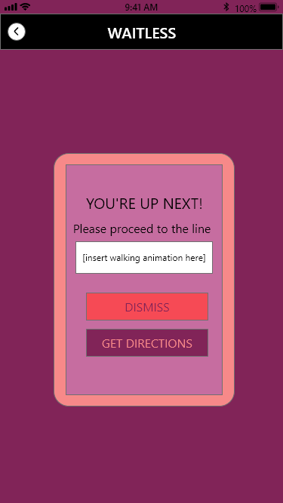
Tasks Prototyped
Notifications to Guide the User
Notes:
Secondly we have notifications. This is a very important task, as it is what prompts the user throughout the queue process. The user becomes notified when they have successfully joined the line, how close they are to the front, and when they are up next. This helps expedite the process with getting people through each line.

Slide 5
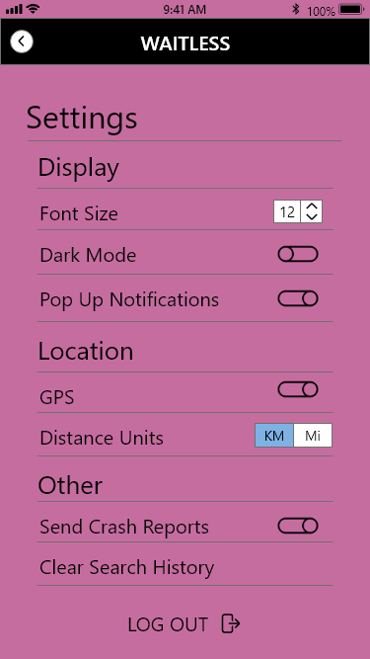
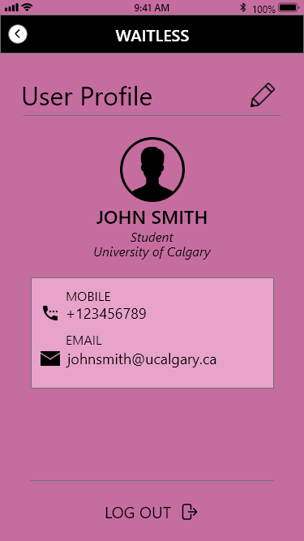
Tasks Prototyped
Modify Settings and Change Profile Information
Notes:
Thirdly, we have modifying the settings and changing profile information. This gives the user freedom to choose how they want to be interacting with the app. Included in the settings, they can disable notifications, change to a dark mode, and change font size. As well, the user can change their information if they have a new email address or phone number.

Slide 6
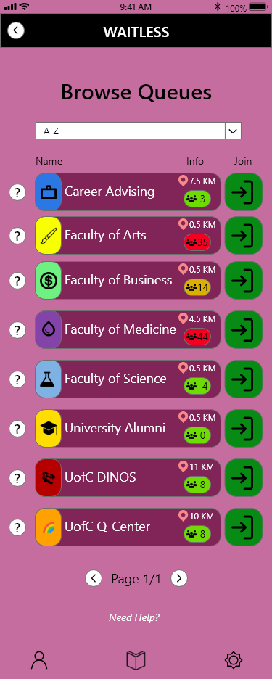
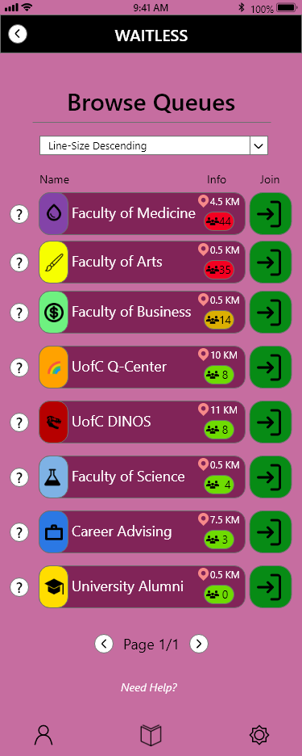
Tasks Prototyped
Sorting of Lines Based on Properties
Notes:
Finally we have sorting the lines. This makes for finding lines you want to join much easier. With this you can sort the lines alphabetically, by distance to the user, and by number of people in the line. With this task, we hope that it leads to better decisiveness for our users when choosing lines to join.

Slide 7

SOFTWARE USED FOR HI-FI Prototype
Notes:
The software that we have chosen and used for our High Fidelity Prototype is Adobe XD. With Adobe XD being a design tool for web apps and mobile apps, we were able to transform our Low Fidelity Prototype into something much more substantial. We agreed as a team to use Adobe XD because of its simplicity in usage and it also had features that would help improve the functionality and design of our prototype.

Slide 8

Demo Video
INSERT VIDEO HERE
Notes:
Here is our Demo Video that illustrates how our app WaitLess functions.

Slide 9

Heuristic Evaluation Process
Notes:
After finishing off the implementations we wanted to add for this Stage of our prototype, we then conducted our heuristic evaluation process. Myself, Evan, and Edmund acted as evaluators along with Amman and Karan acting as reviewers. We were able to determine what we needed to focus and work on for our final product.

Slide 10
Findings & Discussions
Positive Findings
Systems Status Visibility
Information From the Real World
Freedom of Navigation
Flexibility of Use
Negative Findings
Colour and UI Elements
Error Prevention
Recognition Not Utilized Enough
Design of Buttons
Recovery of Errors
Not Enough Help and Documentation
Notes:
These categories from the heuristic evaluation under the positive findings side saw full implementation and never got violated.
Freedom of Navigation is Everywhere with Options To Leave the Queue and Go Back
Information From the Real World is Being Used For Location and Directions
Systems Status Visibility is Sufficient Where Needed
Few actions are required to completely use our app for the functions it provides
Negative findings were never completely violated, but were partially
Colour and UI elements are not always consistent
There was no error prevention when signing up for an account
No auto complete and Recent Searches are not saved, unlike recent lines joined
Some very vibrant colours used for specific faculties that clash with the overall purple colour scheme of the app
Sections in the app, like our settings screens don’t include any help or documentation to give guidance on specifics. Also the help buttons next to each line in the browse and search have no functionality.

Slide 11
Addressing issues
Most Prevalent Problems
Sign Up Page Errors
Help and Documentation Additions
UI Design Clean Up
Notes:
After going over our findings and having discussions, we have decided on the most prevalent problems to change. These include implementing error prevention in our sign up page, adding more help and documentation in screens that don’t currently have enough, and cleaning up some of the UI Design choices with regards to colours and indications.

Slide 12
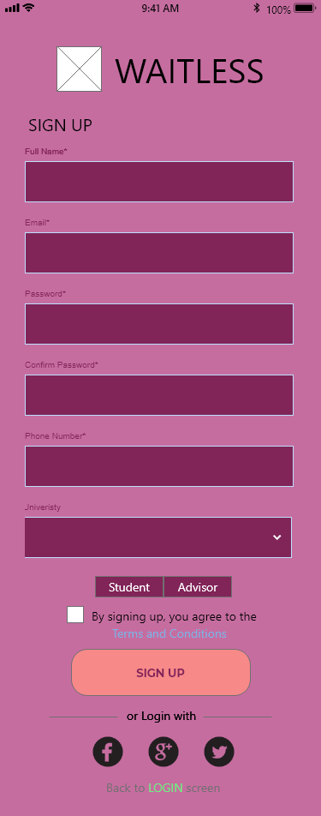
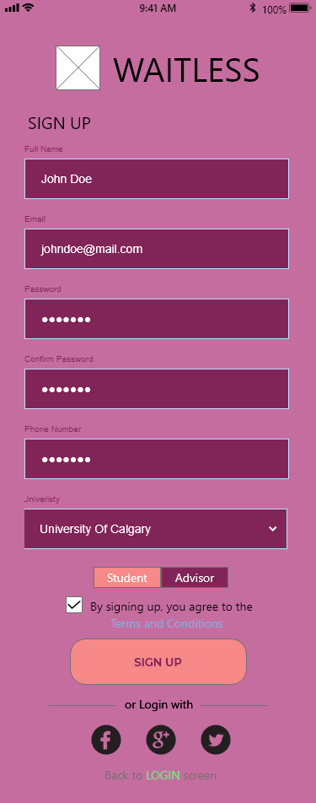
Sign Up page ERROR Prevention

Slide 13
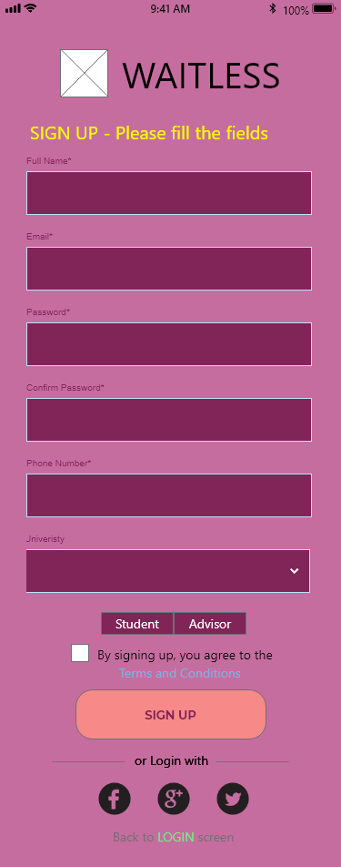
Sign Up page ERROR Prevention

Slide 14
HELP AND DOCUMENTATION ADDITIONS

Slide 15
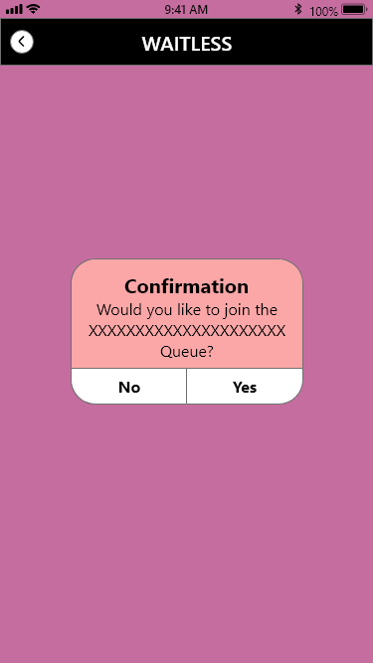
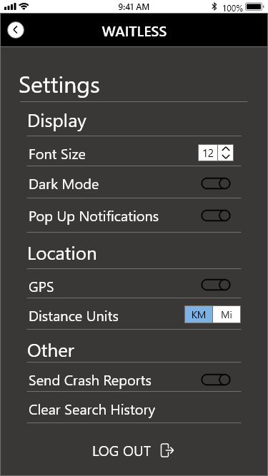
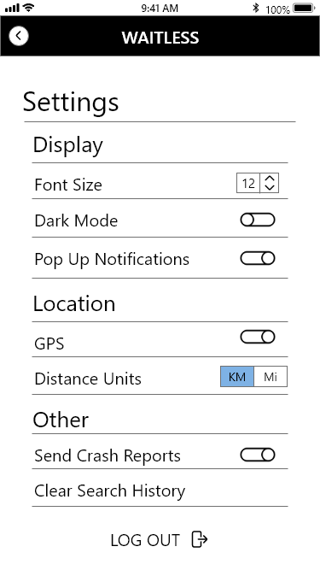
UI DESIGN CLEAN UP

Slide 16
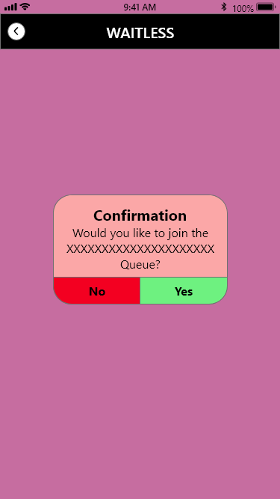
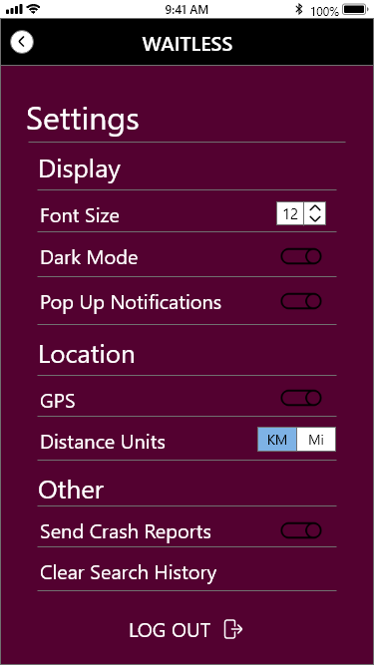

UI DESIGN CLEAN UP

Slide 17
PLANS FOR FINAL STAGE
Take the Prototype to Mobile
Test our Prototype on Mobile with Different Inputs
Improve Functionality with Buttons
Determining a Final UI Colour Scheme
Notes:
Our first plan for the final stage is to take our prototype to a mobile platform. Currently we have been testing and using our app through a PC emulator. Once we have it on our mobile phones, we may find that some things aren’t sized properly or ease of usability is not ideal. With this, we want to test our prototype against finger pressure input. Through our PC emulator, we are able to get precise input with our mouse, but with finger touching through a mobile device could lead to errors in our prototype. As well, we want to have better functionality when it comes to navigating the app. We have buttons in our prototype that will lead to fixed inputs, but sometimes that is not the best way to go about things. We want to have more dynamic input, just like our back buttons taking the user back to the last screen they came from. This can help reduce the number of screens our prototype needs as well. Finally, we want to determine if the colour scheme we have gone with is what we want to go with. We had been debating changes, and with this final stage we will want to come to a consensus.

Slide 18

Conclusion & Thank you
Portfolio: https://rmccurdy.github.io/TeamS_Project/
Repository: https://github.com/RMcCurdy/TeamS_Project
Notes:
Thank you for listening to our stage 4 presentation. You can learn more about our project with the links on this slide.

